Slide 1


Building Conway’s ‘Game Of Life’ in React and Vue
@Paul_Hadfield

Slide 2
Tonight’s Presentation
About me:
Senior Innovation Developer at AutomationSquared
A digital prototype laboratory, based out of Horsham
Has had a love/hate relationship with Javascript since its inception
I’ll introduce:
Conway’s “Game Of Life”
Some basic concepts of React and Vue
A step by step approach to building a working website

Slide 3
What is Conway’s “Game Of Life”?
The Game of Life, also known simply as Life, is a cellular automaton devised by the British mathematician John Horton Conway in 1970
The game is a zero-player game, meaning that its evolution is determined by its initial state, requiring no further input
One interacts with the Game of Life by creating an initial configuration and observing how it evolves, or, for advanced players, by creating patterns with particular properties
Four basic rules govern all game play
Source: Wikipedia

Slide 4
What are the rules?
Every cell interacts with its eight neighbours, which are the cells that are horizontally, vertically, or diagonally adjacent. At each step in time, the following transitions occur:
Any live cell with fewer than two live neighbours dies, as if by underpopulation
Any live cell with two or three live neighbours lives on to the next generation
Any live cell with more than three live neighbours dies, as if by overpopulation
Any dead cell with exactly three live neighbours becomes a live cell, as if by reproduction
Source: Wikipedia

Slide 5
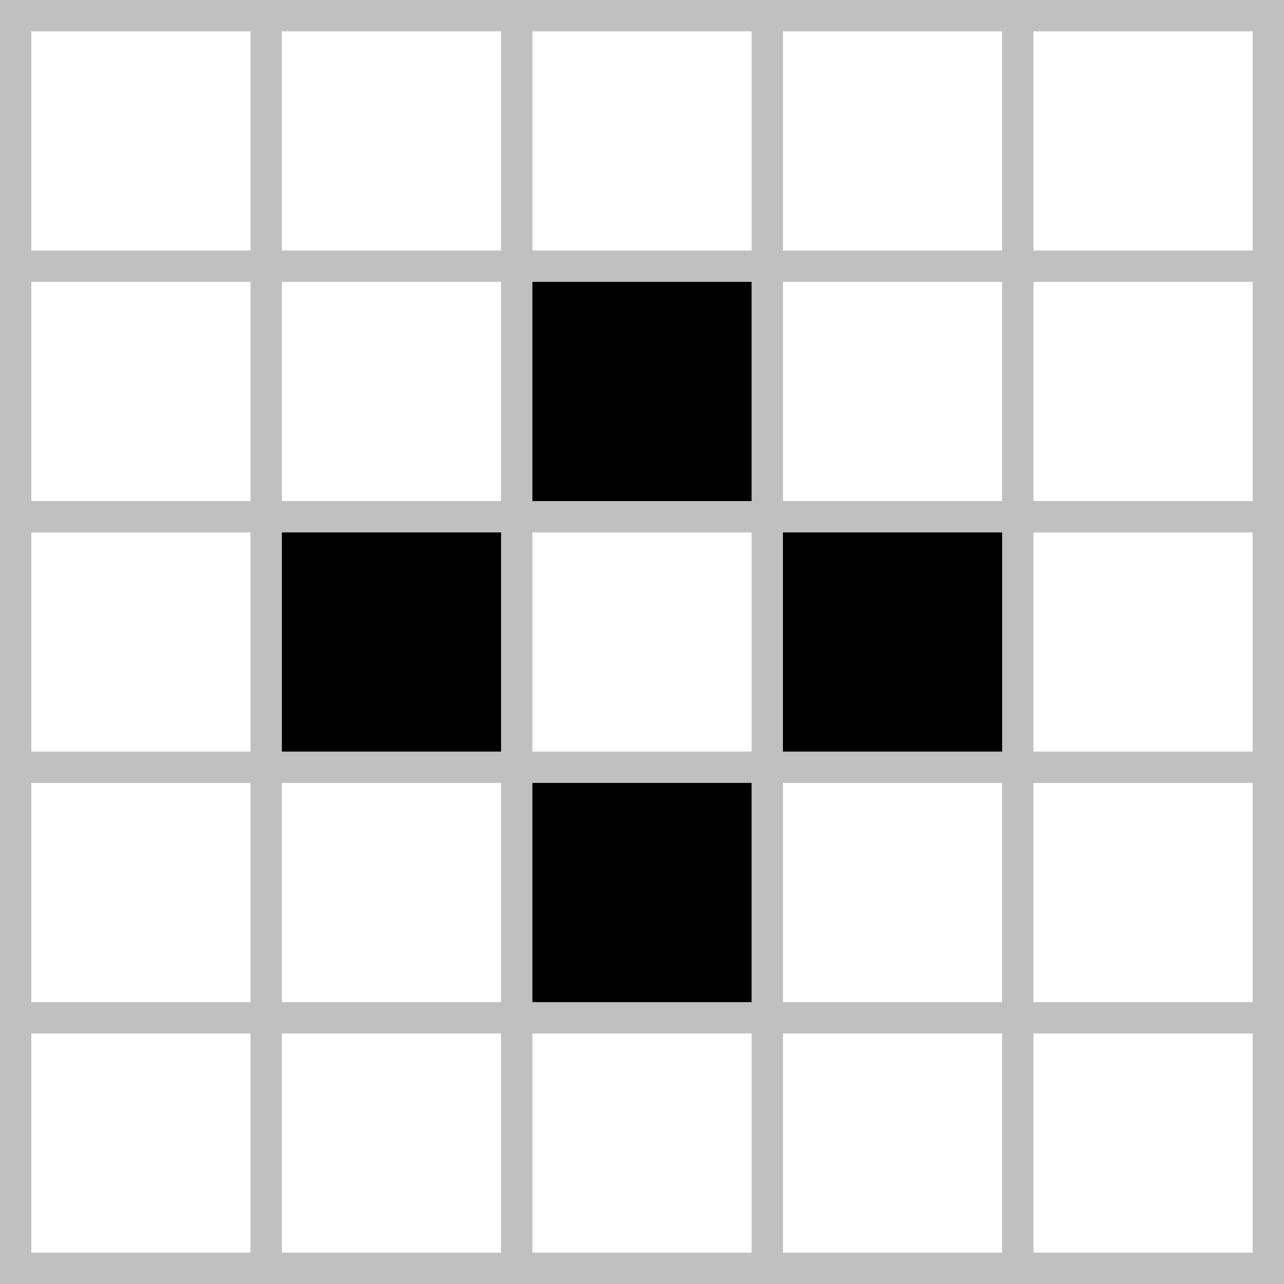
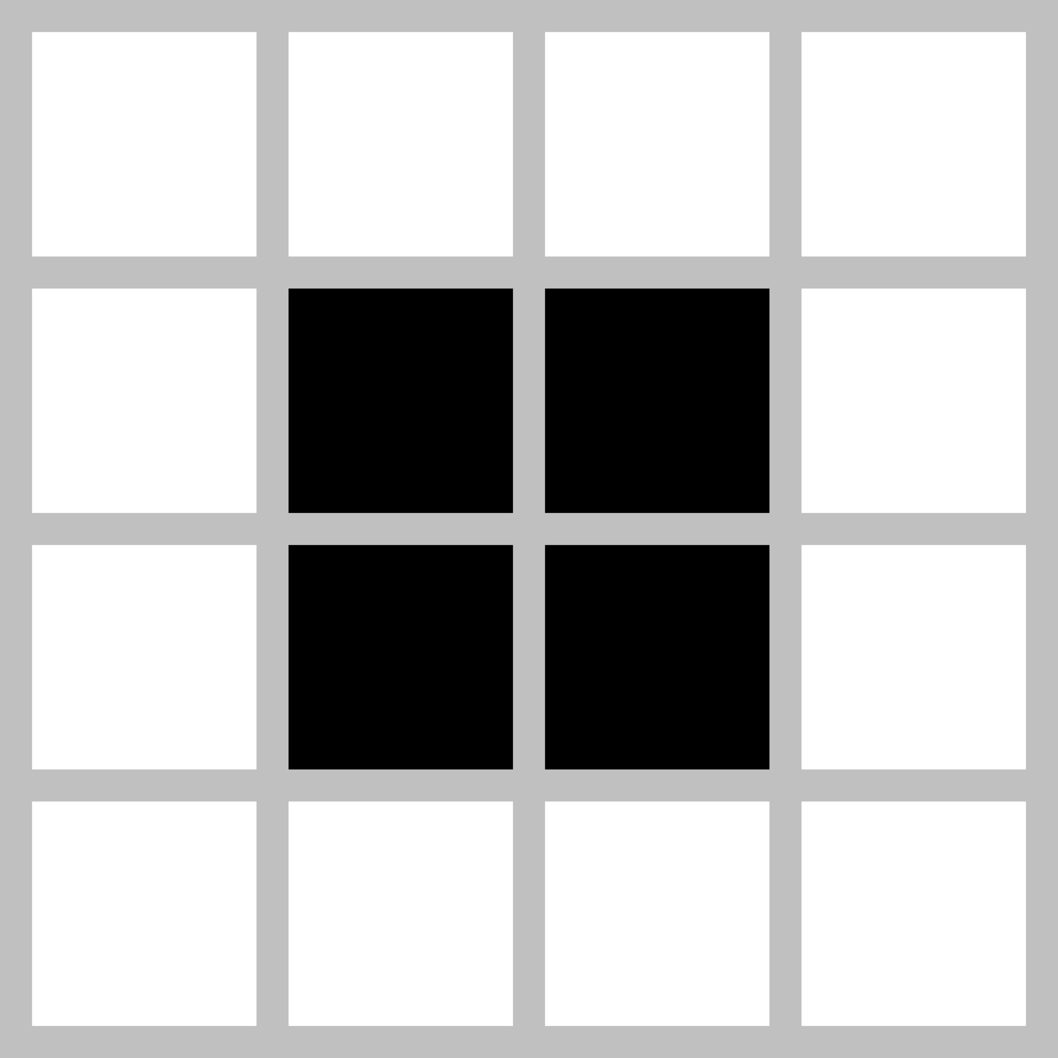
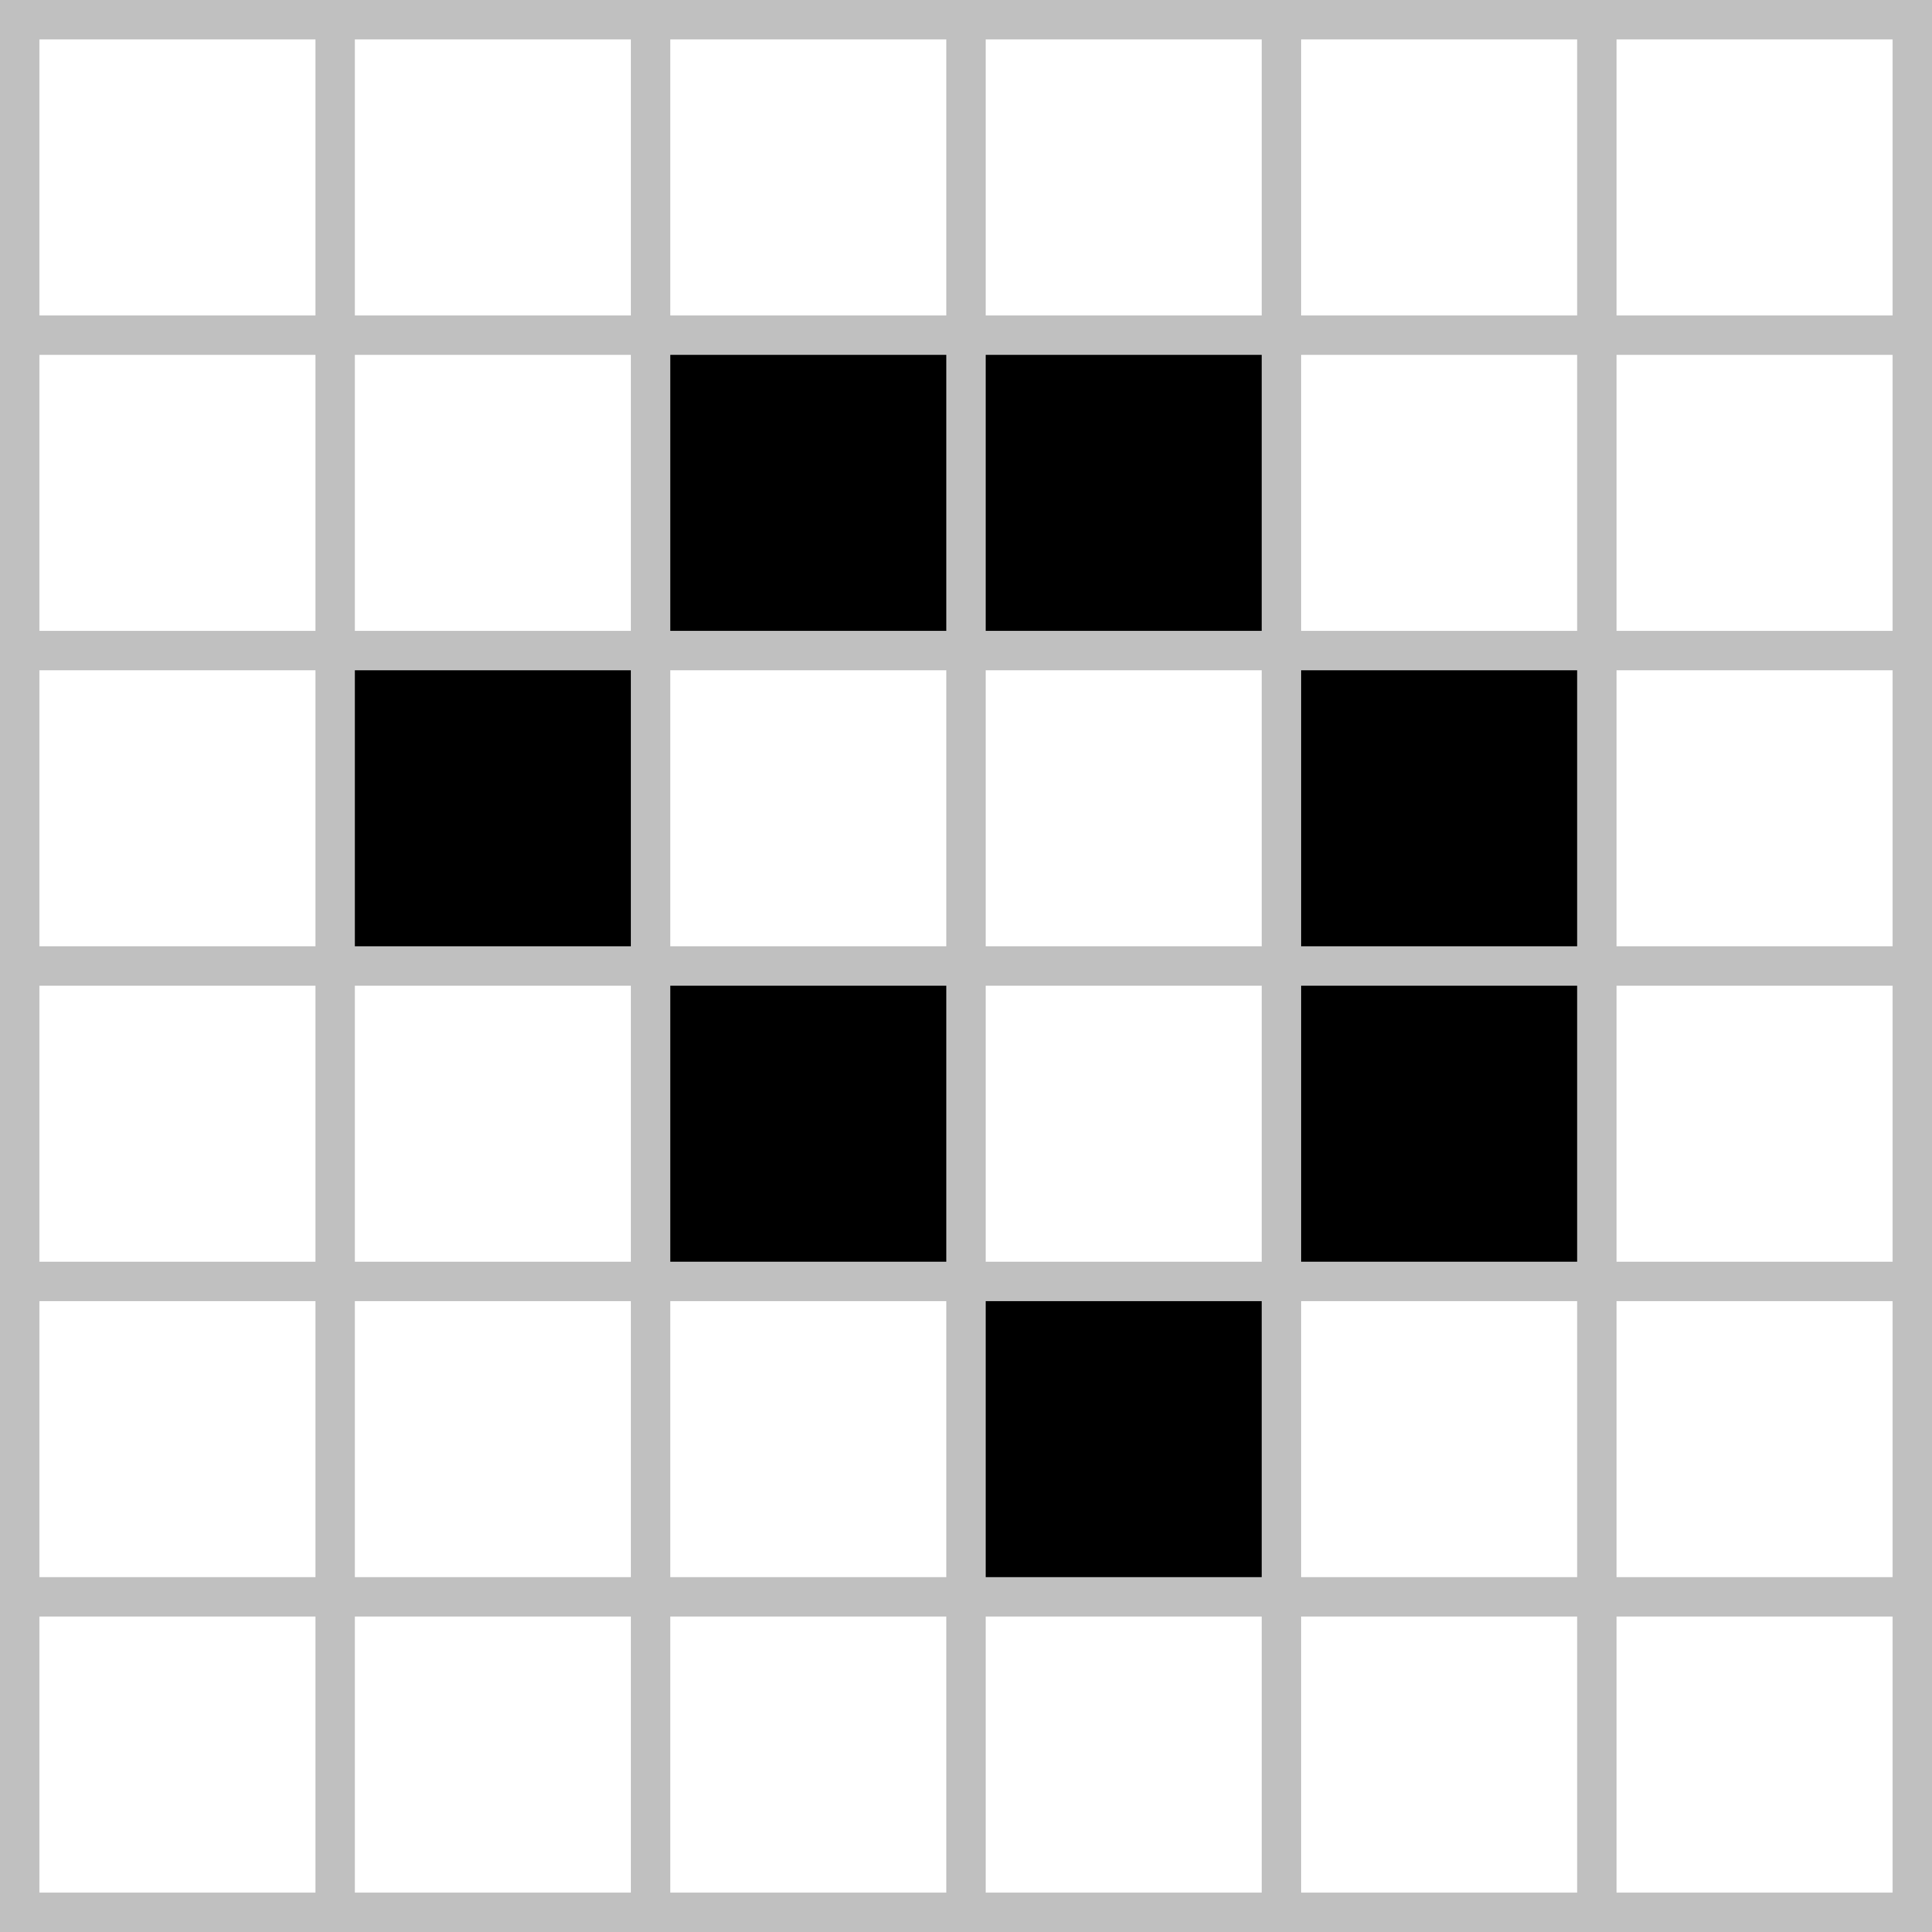
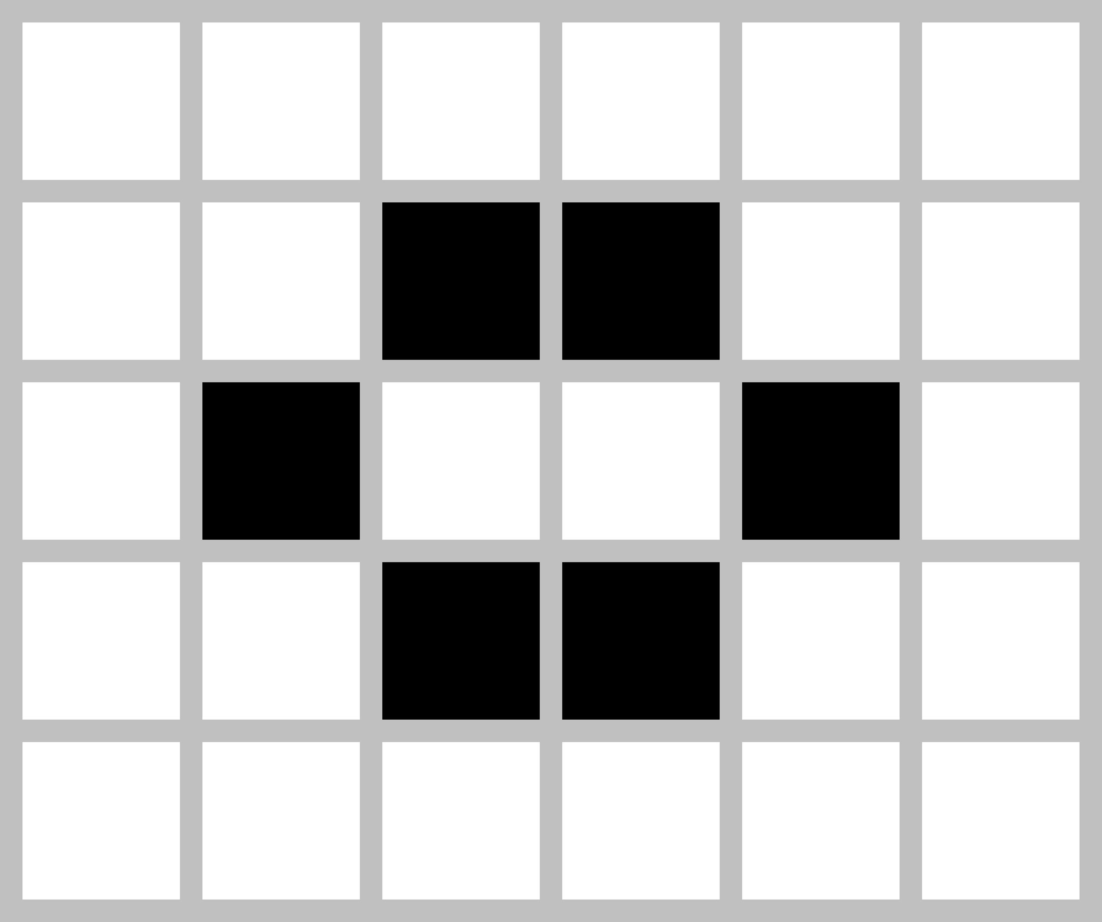
Examples of Patterns
Still Lifes
Oscillators
Tub
Block
Blinker
(period 2)
Toad
(period 2)
Loaf
Beehive
Beacon
(period 2)
Pulsar
(period 3)
Source: Wikipedia

Slide 6
Developing the Game Engine
Any live cell with fewer than two live neighbours dies, as if by underpopulation
Any live cell with two or three live neighbours lives on to the next generation
Any live cell with more than three live neighbours dies, as if by overpopulation
Any dead cell with exactly three live neighbours becomes a live cell, as if by reproduction
Source: Wikipedia

Slide 7
Developing the Game Engine
Any live cell with fewer than two live neighbours dies, as if by underpopulation
Any live cell with two or three live neighbours lives on to the next generation
Any live cell with more than three live neighbours dies, as if by overpopulation
Any dead cell with exactly three live neighbours becomes a live cell, as if by reproduction

Slide 8
Developing the Game Engine
Any live cell with fewer than two live neighbours dies, as if by underpopulation
Any live cell with two or three live neighbours lives on to the next generation
Any live cell with more than three live neighbours dies, as if by overpopulation
Any dead cell with exactly three live neighbours becomes a live cell, as if by reproduction

Slide 9
Developing the Game Engine
Any live cell with fewer than two live neighbours dies, as if by underpopulation
Any live cell with two or three live neighbours lives on to the next generation
Any live cell with more than three live neighbours dies, as if by overpopulation
Any dead cell with exactly three live neighbours becomes a live cell, as if by reproduction

Slide 10
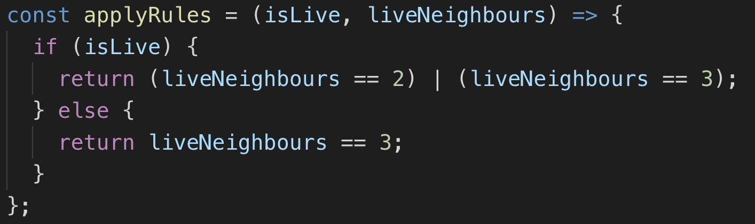
Developing the Game Engine
Any live cell with fewer than two live neighbours dies, as if by underpopulation
Any live cell with two or three live neighbours lives on to the next generation
Any live cell with more than three live neighbours dies, as if by overpopulation
Any dead cell with exactly three live neighbours becomes a live cell, as if by reproduction
newState = applyRules(currentState, liveNeighbours)

Slide 11
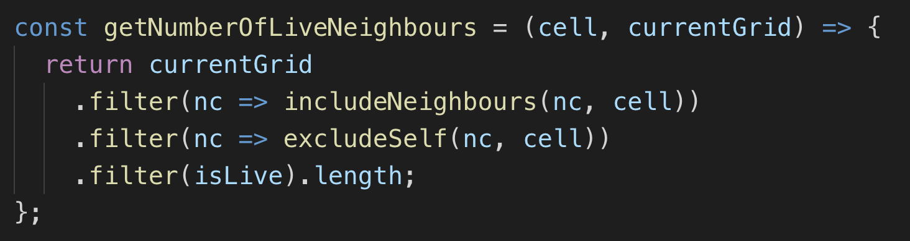
Determining Live Neighbours

Slide 12
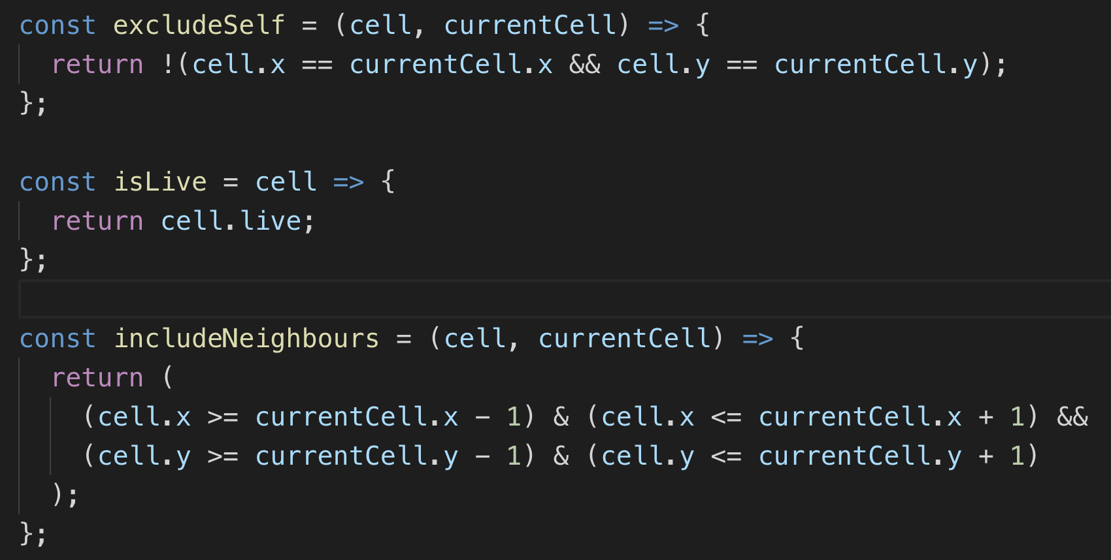
Determining Live Neighbours

Slide 13
Templates for Starting Projects
Options:
Use the CLI (and wait whilst it downloads half the internet as packages)
“vue create gof-vue” and select desired inputs
https://cli.vuejs.org/guide/creating-a-project.html#vue-create
“npm init react-app gof-react”
https://github.com/facebook/create-react-app
Use a prebuilt project template and change settings
For more control/include particular libraries/enforce company standards

Slide 14
Architecture: Common Approach
Four Components:
App
Top level component, responsible for calling Grid and Options Components
Interacts with “Game Of Life” engine and passes data to child component
Grid
Draws the grid and loops through each cell, passing to the Cell component
Cell
Draws the cell
Options
Handles displaying FORM for user interaction (introduced in final demo)

Slide 15
Architecture: Common Approach
Use minimal feature set to implement
Use ES6 features (arrow functions)
Keep things as simple as possible
Try not to use Redux and/or Vuex

Slide 16
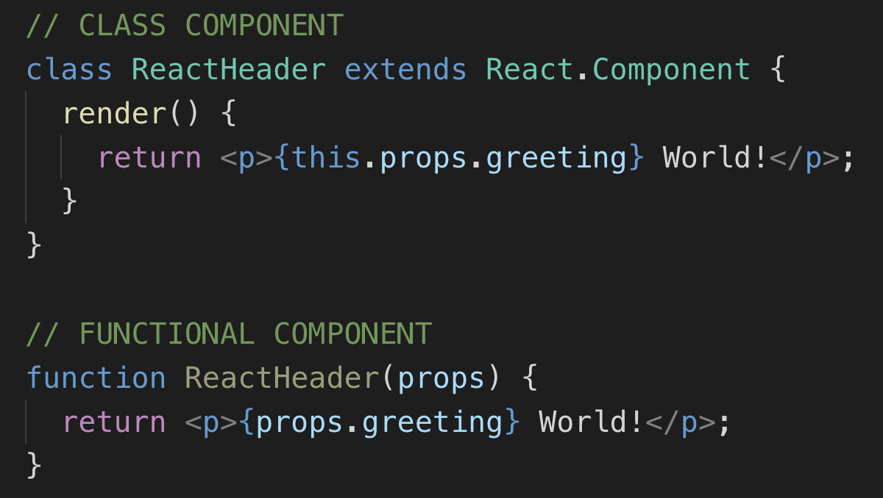
React Approach
Functional Components
New way to create React components
‘React Hooks’ give comparable feature set to class life cycle
ES6 feature, requires Babel to compile

Slide 17
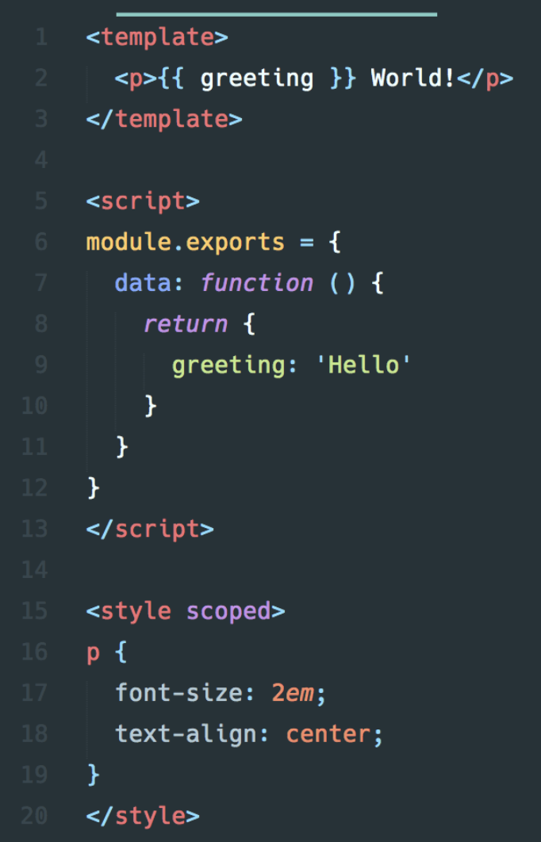
Vue Approach
Single File Components
Template,
Component
Style

Slide 18
Demo 1 – Display Initial State
Demo Time

Slide 19
Styling Components
Apply ‘CSS Grid’ exiting Grid/Cell HTML Div’s
Dynamically calculate grid dimensions
“Game Of Life” examples have different number of rows / columns
Great Resource:
https://gridbyexample.com/examples/

Slide 20
Demo 2 – CSS Grid
Demo Time

Slide 21
React: Updating State
React Hooks
Introduced in React 16.8
Uses the naming convention “use….”
Functional Components are now as powerful as Class Components
useState
Provide an initial state
Returns instance of value and function to set new value (state)
useEffect
Use for ‘Side Effects’ (i.e. HTTP Calls, scheduling calls)
Similar to class component life cycle events “componentDidMount”, “componentDidUpdate” and “componentWillUnmount” combined

Slide 22
Demo 3 – React: Updating State
Demo Time

Slide 23
Vue: Updating State
Uses life cycle events
Created
beforeDestroy

Slide 24
Demo 4 – Vue: Updating State
Demo Time

Slide 25
FORM data / User Interaction
New component:
Options
React
Functions passed in from parent as props, along with initial state
Vue:
Initial state passed in as props
Events emitted to parent

Slide 26
Demo 5 – Select “Initial State” UI
Demo Time

Slide 27
Conclusion
Vue and React are very similar
Both were easy to pick up
React Event hooks work really well
Feels easier passing functions into react
Compared to Vue emitting events
I still have a love/hate relationship with Javascript

Slide 28
Recap
We’ve learnt about and seen examples on how to use:
Modern JavaScript Practises
React Library
Vue Framework
We’ve also then seen how to use the above in combination to:
Build a working Conway’s “Game Of Life” website

Slide 29
Thank you – Any questions?
GitHub: Slides and source code can be found here
https://github.com/Paul-Hadfield/GameOfLife-Talk
Contact me on Twitter: @Paul_Hadfield

